Slide 1

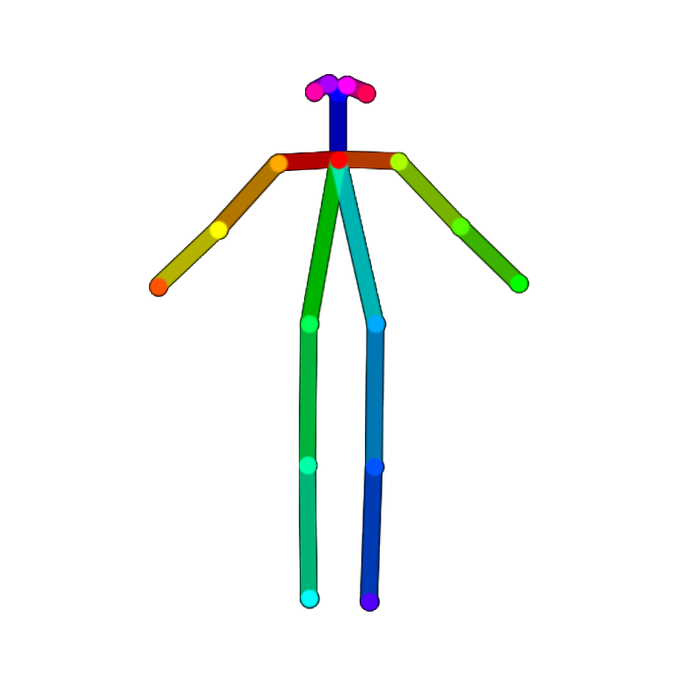
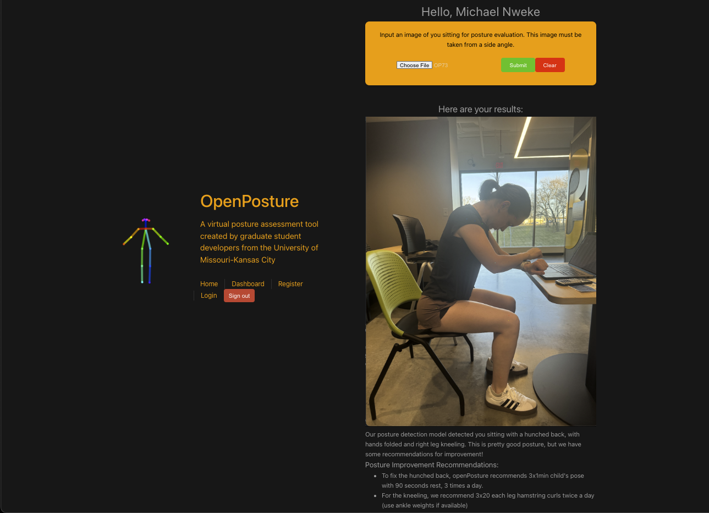
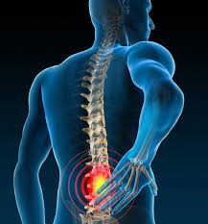
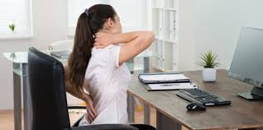
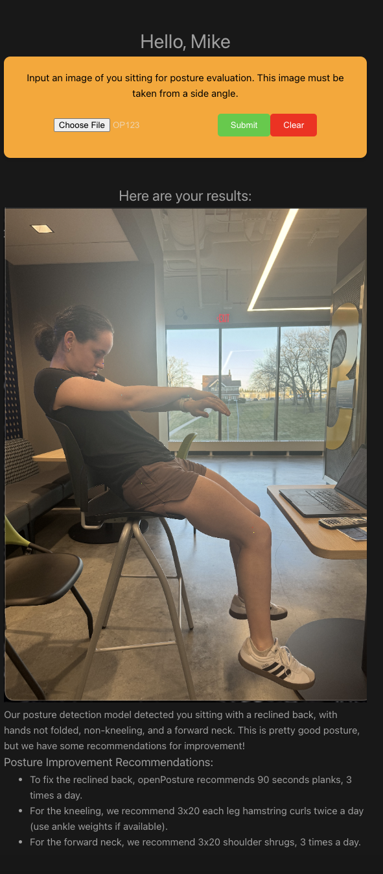
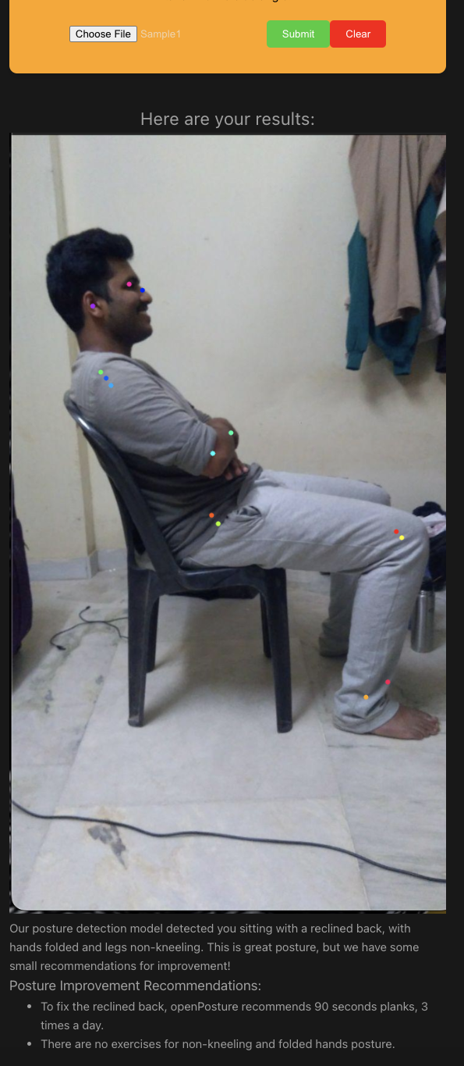
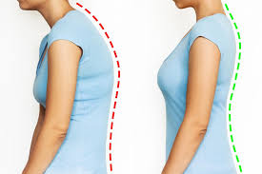
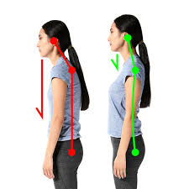
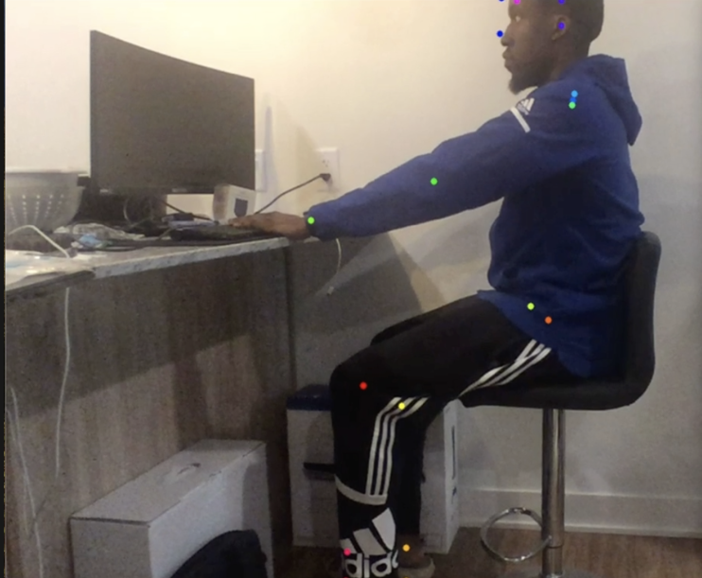

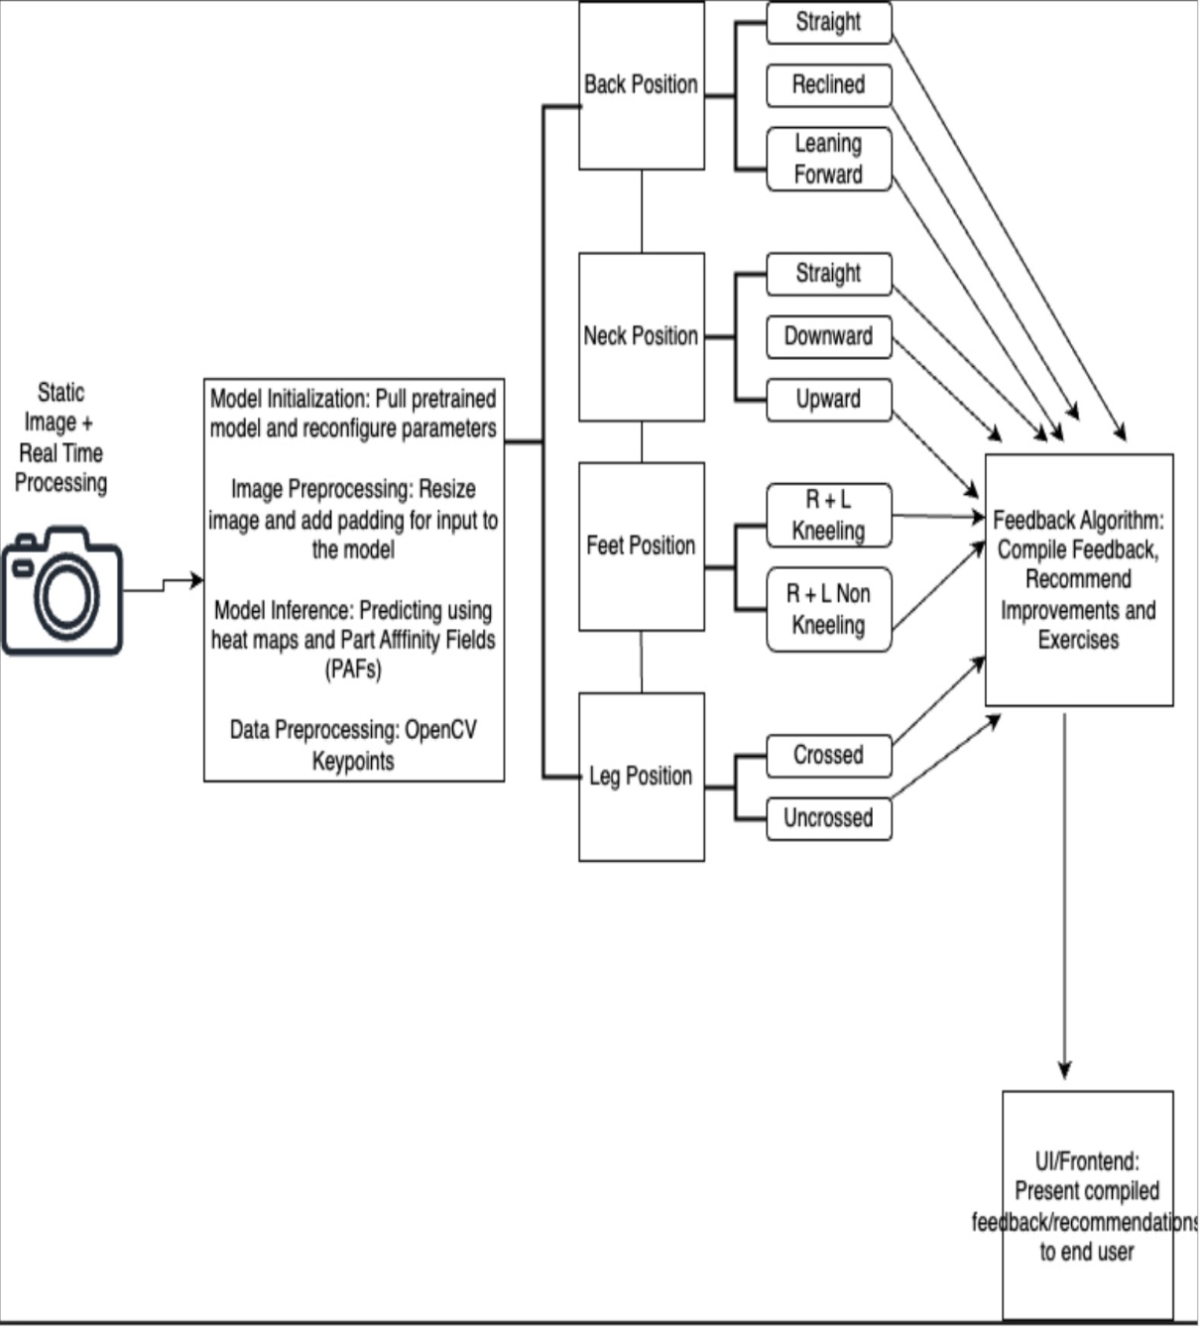
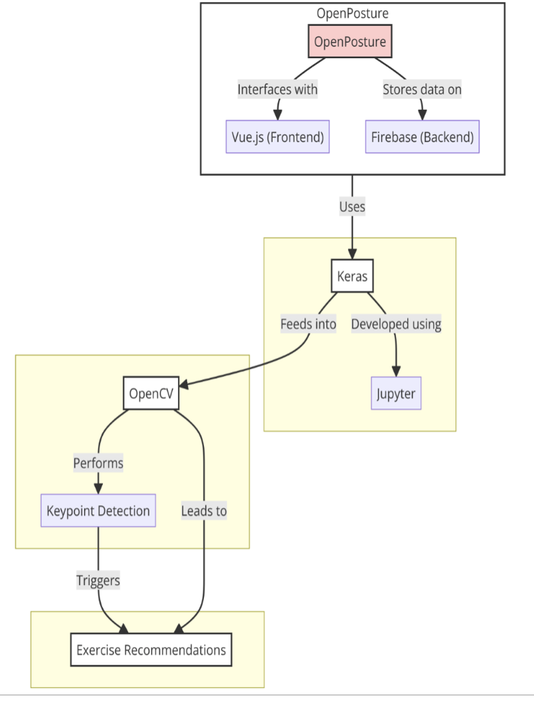
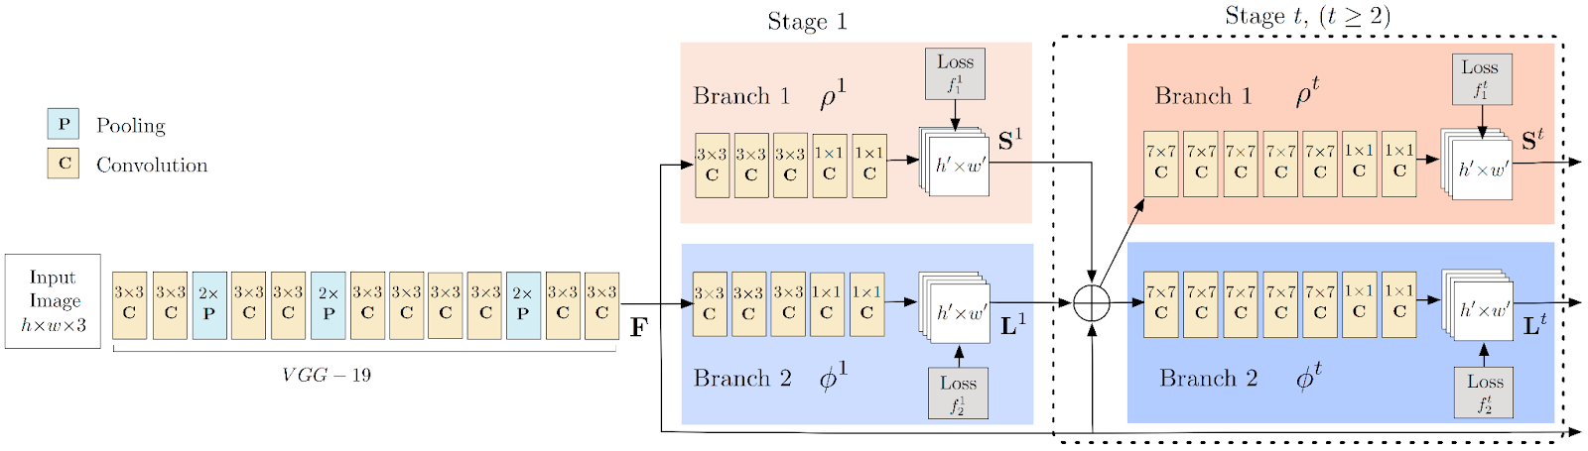



OpenPosture
Michael Nweke, Ally Ryan, and Parisha Rathod
University of Missouri- Kansas City School of Science and Engineering
Introduction
Methodology: Static Image
Results
Conclusion
Welcome to OpenPosture, an innovative solution born from the shared struggle of developers battling neck and back pain during long hours at screens. Recognizing the pervasive nature of this issue, we embarked on a journey to create a practical tool to promote better posture habits and alleviate discomfort. Leveraging Python's OpenCV library and a powerful Keras/TensorFlow model, OpenPosture offers real-time feedback to help users mitigate discomfort and enhance overall health.
Dataset Preparation:
A curated dataset of 144 diverse seated posture images underpins model training, focusing on critical body parts like the back, hands, neck, and feet for accurate posture recognition.
Data Cleaning and Preprocessing:
Images are normalized, resized for uniformity, and augmented to enhance the model's generalization across various seating scenarios, using a Keras model with a VGG-like architecture for efficient preprocessing and analysis.
Posture Analysis:
The system precisely identifies key posture points and assesses posture alignment, leveraging integrated preprocessing to prepare images for optimal analysis. This process pinpoints specific areas needing improvement.
Personalized Feedback:
Based on posture analysis, personalized correction recommendations are generated and delivered through a Vue.js-designed user interface, powered by Firebase, offering users an intuitive and seamless experience in improving their posture.
OpenPosture successfully detects back, neck, feet, leg, and kneeling posture through images and real time. It proposes workouts to help mitigate back and neck pain for each posture and increase productivity. The OpenPosture app will serve as a valuable resource to students across universities and Big4 Accounting Firms through a monthly subscription plan.
Future Work
Object Detection: Integrating real-time object detection capabilities within the OpenPosture system would enhance its ability to recognize and provide insights on specific objects in the user's environment. Such insights might include lowering the chair, raising the desk, or moving the keyboard forward to enable better posture and mitigate pain.
Single-Device Use: Optimizing OpenPosture for single-device use could eliminate logistical challenges for users with a single device and streamline the user experience by removing the need for additional hardware.
Camera Positioning Guidance: Incorporating visual aids, instructions, or alarms/audio cues within the app to assist users in positioning the camera effectively would improve posture assessment accuracy.
Customization: Offering customization options within the app regarding workout capabilities, known medical diagnoses (e.g., scoliosis), age, or physical characteristics (e.g., amputated body part) would cater to diverse user preferences and needs.
5. Subscription Management: Establishing and allowing options for different subscription plans would allow users to choose the version of the app that best suits their needs and financial interests.
Statistics
Studies show that 54% of office workers experience neck pain due to inadequate seated posture.
Low back pain ranks as the leading cause of disability globally.
An alarming 80% of people will experience debilitating lower back pain during their lifetime.
Methodology: Real-time Detection
Setup and Configuration:
The system is meticulously configured with the appropriate hardware and software to capture and analyze real-time posture data effectively. Key to this setup is the strategic positioning of cameras to ensure comprehensive posture capture.
Posture Detection Algorithm:
Real-time video feeds are processed using advanced machine learning models, which perform keypoint detection and posture assessment. Preprocessing techniques, including noise reduction, are integrated to optimize the video input for the detection model, ensuring accurate posture analysis against established metrics.
Feedback Mechanism:
Based on the analysis, an immediate feedback mechanism provides visual cues directly to the user. This responsive system suggests posture adjustments, prompts breaks, or offers specific exercises designed to mitigate any detected posture issues, fostering an interactive and beneficial user experience.
References
Objectives
https://github.com/nvinayvarma189/Sitting-Posture-Recognition
https://store.uprightpose.com/products/upright-go2
At OpenPosture, our mission is clear: to pioneer a transformative approach to ergonomics. We aim to harness sophisticated technology to not only detect suboptimal posture with precision but also intervene with tailored, actionable guidance. Our goal is not just to correct posture; we're redefining the standard for an active, pain-free engagement with daily tasks.
Diagrams

